Slide 1
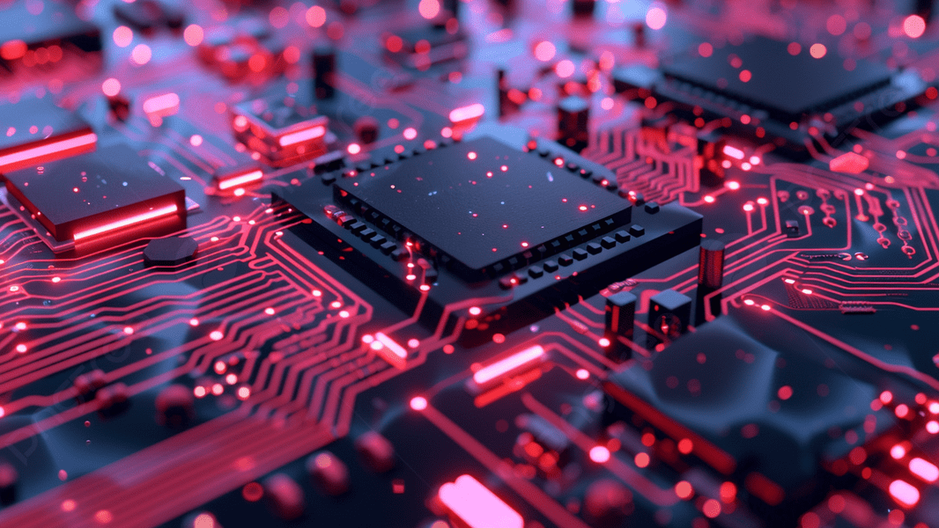
WEEK 2 — COURSE MATERIAL
Applications of ICT
Physical Components of Computer Systems
CPU, Memory, and Computer Types
Lectures 3 & 4

Slide 2
OVERVIEW
Learning Objectives
01
02
Lecture 3: Types of Computers
Lecture 4: CPU and Internal Memory
Explore the physical components of computer systems. Learn about desktop computers, mobile devices, and mainframe systems — their characteristics, components, and use cases.
Understand the central processing unit, its role in executing instructions, and the internal memory hierarchy including cache, ROM, and RAM.
KEY TOPICS
■ Desktop, Mobile, and Mainframe Computer Types
■ Central Processing Unit (CPU) — ALU, Control Unit, Registers
■ The Fetch-Decode-Execute Instruction Cycle
■ Internal Memory — Cache, ROM, and RAM
■ Characteristics and Differences of ROM and RAM
02

Slide 3
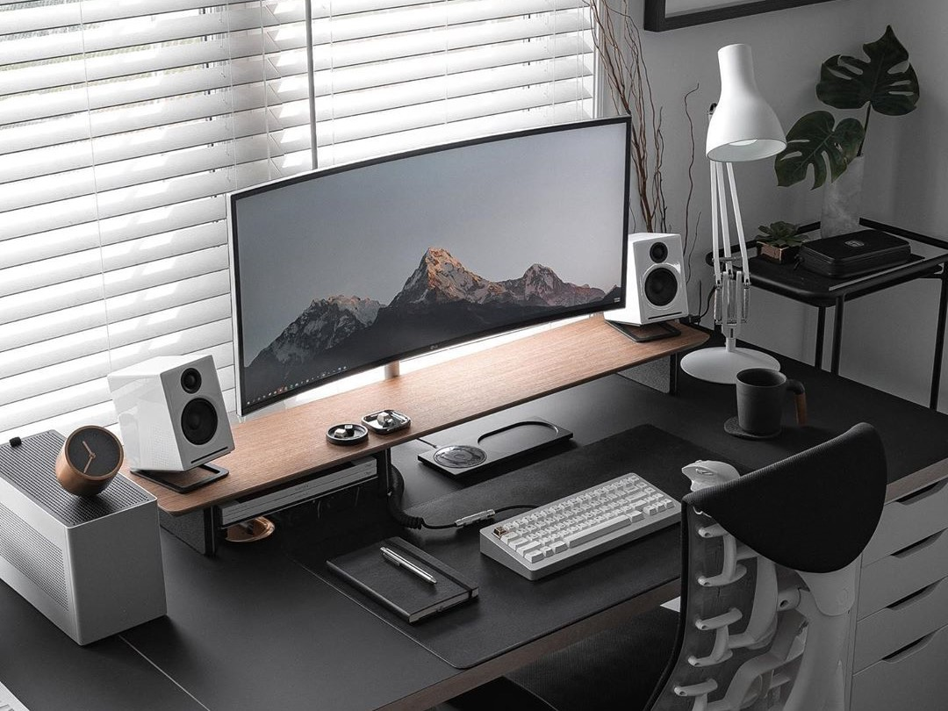
LECTURE 3
Physical Components of Computer Systems
Types of Computers — Desktop, Mobile, and Mainframes

Slide 4
What is a Computer System?
A computer system consists of physical hardware components and software that work together to process data and produce information.
Hardware
Software
The tangible, physical parts of a computer that can be seen and touched. Includes the system unit, input devices (keyboard, mouse), output devices (monitor, printer), and storage devices (hard drive, SSD).
The programs, applications, and instructions that tell the hardware what to do. Includes operating systems (Windows, macOS, Linux) and application software (Word, Excel, browsers).
Why Physical Components Matter
Understanding hardware is essential because physical components determine the computer's capabilities, performance, and suitability for different tasks. The right hardware ensures efficient processing, adequate storage, and reliable operation.
04

Slide 5
Types of Computers — An Overview
Computers come in various sizes and capabilities, each designed for different purposes and users.
Desktop Computers
Mobile Computers
Mainframe Computers
Designed for regular use at a single location. Offer the best performance and upgradeability among personal computers. Ideal for office work, gaming, and professional applications.
Portable devices including laptops, tablets, and smartphones. Balance computing power with mobility. Battery-powered for use anywhere.
Powerful systems used by large organizations for bulk data processing. Support thousands of users with extreme reliability and security.
Key Balancing Factors: Each computer type balances processing power, portability, cost, and energy consumption differently. Understanding these trade-offs helps in selecting the right computer for specific needs.
05

Slide 6
Desktop Computers
Desktop computers are personal computing devices designed for use at a fixed location. They consist of a separate system unit, monitor, keyboard, and mouse.
Key Characteristics
■ Most powerful processing among personal computers
■ Highly customizable — easy to upgrade RAM, GPU, storage
■ Cost-effective — best performance per dollar spent
■ Not portable — requires external power supply
Common Uses
Modern desktop workstation setup
■ Office work and productivity
■ Gaming and graphic design
■ Programming and scientific computing
Form Factors: Tower (traditional upright case), All-in-One (monitor with built-in computer), Mini PC (compact, space-saving), and Workstation (high-performance for professional use).
06

Slide 7
Desktop Computer Components
System Unit
Monitor
Keyboard & Mouse
Houses the motherboard, CPU, RAM, power supply, and storage drives in a protective case.
Displays visual output. Types include LCD, LED, and OLED in various sizes and resolutions.
Primary input devices for user interaction. Available in wired and wireless configurations.
Motherboard
Power Supply (PSU)
Storage Drive
The main circuit board connecting all components. Contains RAM slots, CPU socket, and expansion slots.
Converts AC power from the wall to DC power for all internal components. Rated in watts.
HDDs use magnetic disks; SSDs use flash memory. Stores the OS, programs, and user files.
Graphics Card (GPU)
Renders images and video. Essential for gaming, video editing, and 3D applications.
07

Slide 8

Mobile Computers — Laptops
Laptops (notebook computers) integrate all components — display, keyboard, trackpad, CPU, memory, and storage — into a single compact portable unit.
Key Characteristics
■ Battery-powered — use without external power
■ Lightweight and compact — easy to transport
■ Built-in wireless — Wi-Fi and Bluetooth
■ Lower performance than equivalent desktops
■ Limited upgradeability — most parts soldered
Laptop, tablet, and smartphone — mobile computing devices
Ideal for: Students, business travelers, and professionals who need computing power on the go. Modern laptops range from ultralight notebooks (1-1.5 kg) to powerful gaming laptops with dedicated GPUs.
08

Slide 9
Mobile Computers — Tablets & Smartphones
Tablets
Smartphones
■ Touchscreen-based interface — no physical keyboard
■ Screen size: 7 to 13 inches
■ Ideal for media consumption, reading, and light productivity
■ Longer battery life than laptops
■ Examples: Apple iPad, Samsung Galaxy Tab
■ Pocket-sized with cellular connectivity
■ Most widely used computing device globally
■ Combines communication, computing, camera, GPS
■ Run mobile OS: iOS or Android
■ Use apps instead of traditional desktop software
The Mobile Revolution
Both tablets and smartphones represent a shift toward post-PC computing. They prioritize convenience, instant-on functionality, and app-based ecosystems over the flexibility of traditional desktop operating systems.
09

Slide 10
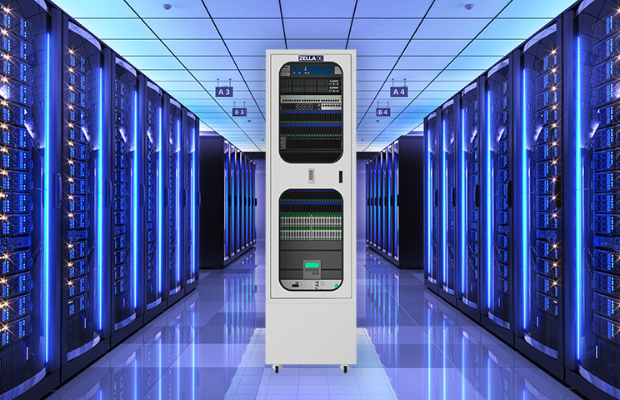
Mainframe Computers
Mainframe computers are large, powerful, and expensive computing systems used by large organizations for critical applications and bulk data processing.
Key Characteristics
■ Process millions of instructions per second
■ Support thousands of simultaneous users
■ 99.999% uptime — "five nines" reliability
■ Run specialized OS: z/OS, z/VM
■ Store vast data with high security
Enterprise data center with server racks
Evolution: Mainframes have evolved from room-sized machines of the 1960s to modern compact systems. Today's mainframes use advanced virtualization, enabling multiple operating systems to run simultaneously on a single physical machine.
10

Slide 11
Mainframe Applications & Features
Industry Applications
Banking & Finance
Insurance
Healthcare
ATM withdrawals, credit card payments, millions of daily transactions
Policy data management, claims processing, risk assessment
Patient records, medical billing, pharmaceutical tracking
Government
Airlines
Tax processing, social security, census data management
Reservation systems, flight scheduling, baggage tracking
Key Technical Features
■ Hardware redundancy — duplicate components ensure fault tolerance; if one fails, another takes over instantly
■ Hot-swappable components — parts can be replaced without shutting down the system
■ Advanced encryption — hardware-level security features protect sensitive data
■ Virtualization — multiple operating systems run simultaneously on one physical machine
■ Parallel processing — handles massive workloads by distributing tasks across processors
11

Slide 12
Comparing Computer Types
Feature | Desktop | Laptop | Tablet | Phone | Mainframe
Processing | High | Medium-High | Medium | Low-Med | Very High
Portability | None | High | Very High | Very High | None
Cost Range | $ - $$ | $$ - $$$ | $$ - $$$ | $$ - $$$ | $$$$$
Primary Use | General purpose | Mobile work | Media | Communication | Enterprise
Upgradeable | High | Limited | None | None | Modular
Power Source | AC Outlet | Battery/AC | Battery | Battery | AC Power
Key Insight: No single computer type is best for all situations. The optimal choice depends on balancing performance needs, mobility requirements, budget constraints, and the specific tasks to be performed.
12

Slide 13
Key Takeaways — Lecture 3
1
Computer systems consist of physical hardware components that work with software to process data and produce meaningful output.
2
Desktop computers offer the best performance and upgradeability for fixed-location use, making them ideal for demanding tasks.
3
Mobile computers (laptops, tablets, smartphones) prioritize portability with varying levels of computing power for different needs.
4
Mainframe computers provide extreme processing power and reliability for enterprise-level applications requiring 99.999% uptime.
5
The choice of computer type depends on balancing performance, portability, cost, and specific use case requirements.
13

Slide 14
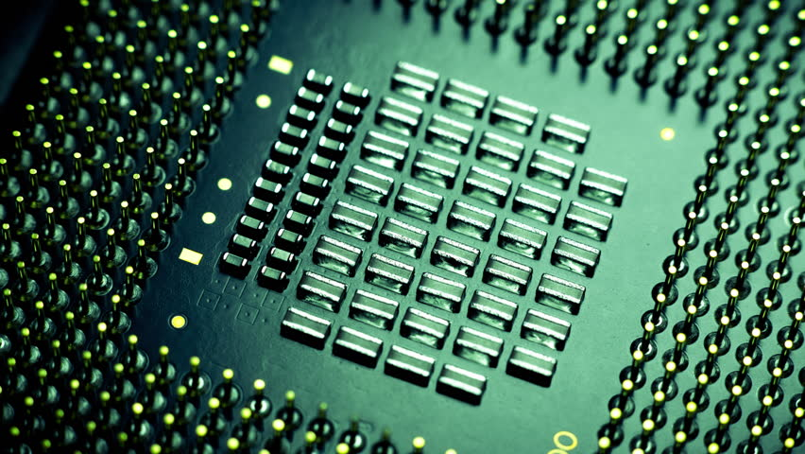
LECTURE 4
CPU and Internal Memory
The Central Processing Unit, Cache, ROM, and RAM

Slide 15
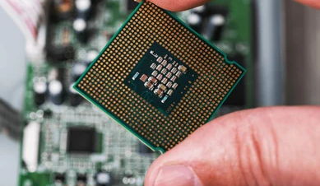
What is the Central Processing Unit?
The CPU is the "brain" of the computer — the primary component responsible for interpreting and executing instructions from the computer's memory.
The CPU performs arithmetic calculations, makes logical decisions, and coordinates the activities of all other hardware components in the system.
Processing Speed
Measured in gigahertz (GHz) — billions of cycles per second. A 3.0 GHz CPU performs 3 billion cycles each second. Modern CPUs execute billions of instructions per second.
Core Functions
■ Performs arithmetic and logical operations
■ Fetches, decodes, and executes program instructions
■ Controls data flow between components
■ Manages input/output operations
A modern CPU processor with contact pins
15

Slide 16
CPU Components — ALU & Control Unit
The CPU contains three primary functional units that work together to process instructions:
Arithmetic Logic Unit (ALU)
Control Unit (CU)
Performs all mathematical operations:
■ Addition, subtraction, multiplication, division
■ Logical comparisons: AND, OR, NOT, XOR
■ Comparison operations (equal, greater than)
Directs and coordinates all CPU operations:
■ Fetches instructions from memory
■ Decodes instructions into commands
■ Generates control signals for execution
Memory Unit
Manages the flow of data between the CPU, internal memory (RAM), and other system components via the system bus.
Working Together: The ALU and Control Unit operate in a continuous cycle. The CU fetches and decodes instructions, then directs the ALU to perform the required calculations, creating a seamless processing pipeline.
16

Slide 17
CPU Components — Registers
Registers are small, ultra-fast storage locations inside the CPU that hold data and instructions being processed. They provide the fastest data access in the entire computer system.
Program Counter (PC)
Instruction Register (IR)
Stores the memory address of the next instruction to be executed. Automatically increments after each fetch.
Holds the instruction currently being decoded and executed by the Control Unit.
Memory Address Register (MAR)
Memory Data Register (MDR)
Holds the address of the memory location currently being accessed by the CPU.
Holds data being transferred to or from memory. Also called Memory Buffer Register (MBR).
Accumulator (ACC)
Speed Hierarchy: Registers are the fastest storage in a computer — faster than cache, RAM, and all other memory types.
Stores the result of arithmetic and logical operations performed by the ALU.
17

Slide 18
How the CPU Processes Instructions
The CPU transforms user input into meaningful output through a continuous processing cycle:
STEP 1
STEP 2
STEP 3
STEP 4
STEP 5
STEP 6
Input
Fetch
Decode
Execute
Store
Output
Input: User enters data via input devices — keyboard, mouse, touchscreen, microphone, or scanner.
Fetch: CPU retrieves the next instruction from memory using the Program Counter address.
Decode: Control Unit interprets the instruction, identifying the operation and data needed.
Execute: ALU performs the calculation or the Control Unit moves data as instructed.
Store: Results are saved to memory (RAM) or a register for later use.
Output: Results are displayed via output devices — monitor, printer, or speakers.
Continuous Cycle: This process repeats billions of times per second, enabling the computer to perform complex tasks from simple calculations to rendering 3D graphics and running artificial intelligence models.
18

Slide 19
The Fetch-Decode-Execute Cycle
The instruction cycle is the fundamental process by which the CPU executes every program instruction:
1
Fetch
2
Decode
3
Execute
The Control Unit retrieves the next instruction from the memory address in the Program Counter.
The instruction is loaded into the Instruction Register, and the PC is incremented.
The Control Unit interprets the binary instruction in the IR.
It identifies the opcode (what operation) and operands (data/registers involved), then generates control signals.
The ALU performs the operation or data is moved between registers and memory.
Results are stored in the Accumulator or written back to memory.
Pipelining in Modern CPUs
Modern CPUs overlap these stages — while one instruction executes, the next is decoded and a third is fetched, dramatically increasing throughput.
19

Slide 20
Internal Memory Overview
Internal memory (primary memory) refers to storage components the CPU can access directly. It stores data and instructions the computer is currently using.
The Memory Hierarchy
Registers
Fastest / Smallest
Cache (L1-L3)
Very Fast / Small
RAM
Fast / Medium
Storage (HDD/SSD)
Slow / Largest
Cloud
Slowest / Huge
Increasing Speed →
→ Increasing Capacity
Types of Internal Memory
Cache Memory
ROM
RAM
Ultra-fast buffer between CPU and RAM. Stores frequently accessed data.
Non-volatile memory storing permanent boot instructions and firmware.
Volatile working memory holding active programs and data. Fast read/write access.
Performance Impact: Internal memory directly impacts system performance. Faster memory with adequate capacity ensures the CPU is not left waiting for data, maximizing overall system responsiveness.
20

Slide 21
Cache Memory
Cache memory is a small amount of extremely fast memory located close to or inside the CPU. It stores frequently accessed data to reduce waiting time for RAM.
L1 Cache
L2 Cache
L3 Cache
PRIMARY CACHE
SECONDARY CACHE
TERTIARY CACHE
■ Size: 32-64 KB
■ Fastest cache level
■ Inside the CPU core
■ Separate I-Cache and D-Cache
■ Size: 256 KB - 1 MB
■ Slightly slower than L1
■ Per-core or shared
■ Unified (instructions + data)
■ Size: 4-64 MB
■ Shared across all cores
■ Slower than L1/L2
■ Still faster than RAM
How Cache Works
When the CPU needs data, it checks cache first. A cache hit provides instant access; a cache miss requires slower RAM access. Modern CPUs achieve 95%+ hit rates through predictive algorithms.
21

Slide 22
ROM — Read-Only Memory
Read-Only Memory (ROM) is non-volatile internal memory that permanently stores instructions essential for starting the computer. Data is written during manufacturing.
What ROM Stores
Boot-up Instructions
Firmware
System Initialization
BIOS/UEFI — the first code executed when the computer starts. Initializes hardware.
Low-level software embedded in hardware devices to control their operation.
Routines that check hardware and load the operating system into RAM.
Key Characteristics of ROM
■ Non-volatile — data persists without power; contents retained when computer is off
■ Read-only — cannot be modified or erased through normal computer operations
■ Reliable — immune to computer viruses and accidental data deletion
■ Permanent — data is written during the chip manufacturing process
■ Essential — without ROM, the computer cannot boot or initialize hardware
22

Slide 23
ROM Characteristics & Types
Types of ROM
Mask ROM
PROM
Data written during chip fabrication. Cannot be changed. Used for mass-produced devices.
Programmable ROM — can be programmed once by the user using a special device.
EPROM
EEPROM
Erasable PROM — can be erased with ultraviolet light and reprogrammed.
Electrically Erasable PROM — erased and reprogrammed electrically, byte by byte.
Flash Memory
A modern type of EEPROM used in SSDs, USB drives, and memory cards. Allows block-level erasure and rewriting — the foundation of modern solid-state storage.
Evolution of ROM Technology
ROM technology has evolved from completely fixed (Mask ROM) to increasingly flexible forms. Modern flash memory bridges the gap between ROM and RAM — it is non-volatile like ROM but can be rewritten like RAM, enabling USB drives, SSDs, and memory cards that transformed portable storage.
23

Slide 24
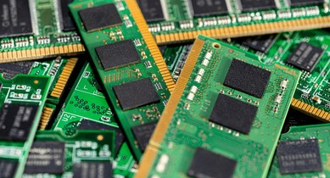
RAM — Random Access Memory
RAM is the computer's main working memory — volatile memory that temporarily stores programs, data, and instructions the CPU is actively using.
Key Characteristics
■ Volatile — all data lost when power is turned off
■ Read/Write — data can be read and written constantly
■ Fast — much faster than secondary storage (HDD/SSD)
■ Direct Access — CPU accesses any location directly
■ Capacity Matters — more RAM = better multitasking
RAM memory modules (DIMMs)
RAM Capacity Impact
RAM capacity directly affects multitasking. More RAM allows more applications to run simultaneously without swapping to slower storage, maintaining smooth performance.
24

Slide 25
RAM Characteristics & Types
SRAM (Static RAM)
DRAM (Dynamic RAM)
■ Uses flip-flop circuits (transistors)
■ Faster but more expensive
■ Does not need refreshing
■ Lower density (takes more space)
■ Used for cache memory
■ Uses capacitors to store data
■ Slower but cheaper than SRAM
■ Requires periodic refreshing
■ Higher density (more capacity)
■ Used as main memory
Evolution: SDRAM and DDR Generations
Feature | DDR3 | DDR4 | DDR5
Speed | 800-2133 MT/s | 1600-3200 MT/s | 3200-6400 MT/s
Voltage | 1.5V | 1.2V | 1.1V
Max Capacity | 16 GB/module | 32 GB/module | 64 GB/module
Each DDR generation offers increased speed, reduced power consumption, and higher capacity per module.
25

Slide 26
ROM vs RAM — Key Differences
Attribute | ROM | RAM
Volatility | Non-volatile — retains data without power | Volatile — loses data when power is off
Read/Write | Primarily read-only | Both read and write operations
Purpose | Stores boot instructions and firmware | Stores active programs and data
Speed | Slower read access | Faster read/write access
Capacity | Small — typically MBs | Large — typically GBs (4-128 GB)
Modifiability | Cannot be modified (or difficult) | Freely modified during operation
Location | On motherboard as chips | Removable modules (DIMMs)
Together, ROM and RAM are essential partners: ROM provides the permanent instructions to start the system, while RAM provides the flexible workspace for active computing.
26

Slide 27
Key Takeaways — Lecture 4
1
The CPU is the brain of the computer, executing instructions through the Fetch-Decode-Execute cycle at billions of cycles per second.
2
CPU components — ALU, Control Unit, and Registers — work together to process data, decode instructions, and produce output.
3
Cache memory provides ultra-fast temporary storage (L1, L2, L3) to bridge the speed gap between the CPU and RAM.
4
ROM is non-volatile memory storing permanent boot instructions and firmware essential for system startup.
5
RAM is volatile working memory that temporarily holds active programs and data, directly impacting system performance and multitasking capability.
27

Slide 28
WEEK 2 SUMMARY
Summary & Next Steps
Physical components determine a computer's capabilities, performance, and purpose. The CPU and memory work together as the heart of every computing system.
LECTURE 3 COVERED
LECTURE 4 COVERED
Types of Computers: Desktop, Mobile, Mainframes
CPU, Internal Memory: Cache, ROM, and RAM
Week 3: Software Components and Operating Systems

